Slide 1
Between Two Worlds:
The Inner Lives of Children of Divorce
Your name:
Course Name:
University:

Slide 2
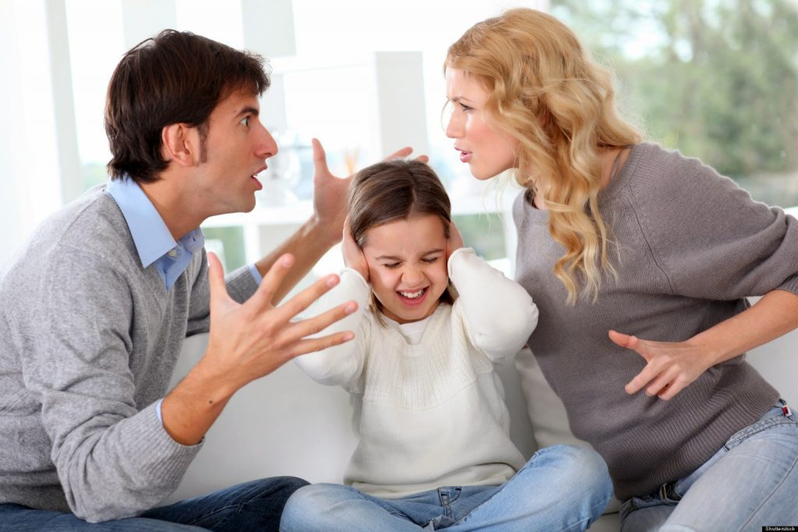
Book Summary
The book is written two authors, Elizabeth Marquardt and Judith Wallenstein.
The two have used the book to show the current state of divorce and how it affects children

Slide 3
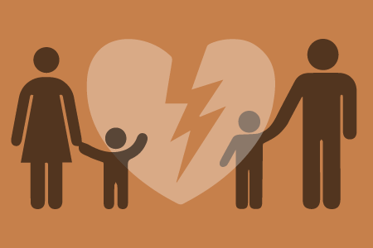
They prove to the world through their research whose findings are presented in the book that so many children are growing in families which experience divorce issues

Slide 4
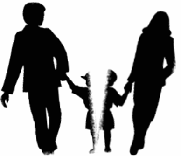
Marquardt presents the results together with other stories of young children who have had these encounters as well as her stories when she was young and how she grew up.
She claims that children are greatly molded by divorce and hence there is a huge difference between those who have grown in divorced families and those that have grown under the intact ones.

Slide 5
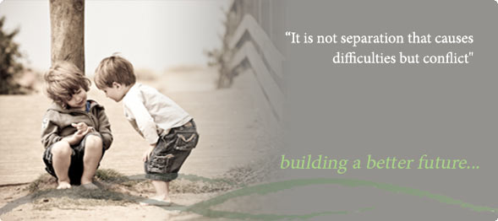
The difference comes in their development, hence children who have been affected by divorce can never grow to be fine at all as much as they may seem so

Slide 6
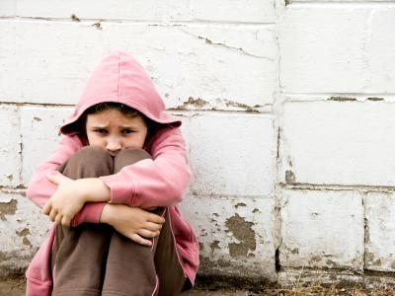
The author also raises the concepts of good divorces and blended families.
She claims that some people argue that there are good divorces in the sense that parents just decide to divorce without so much complains and fights and hence this is not likely to affect their children.

Slide 7
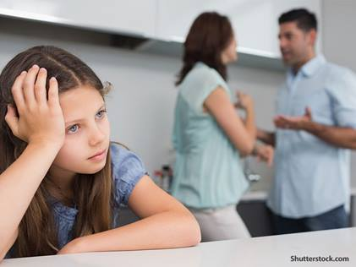
On the other hand, she refutes the claim that there are blended families because her research shows that children are highly affected by any type of divorce and sometimes they may hide their feelings just to please their parents, yet deep down they are not happy.

Slide 8
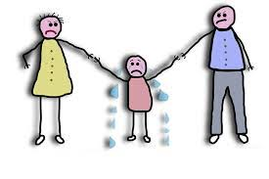
The concept of two worlds in her books is revealed whereby children who belong to divorced families have to travel to both families so that they may visit their father and mother.

Slide 9
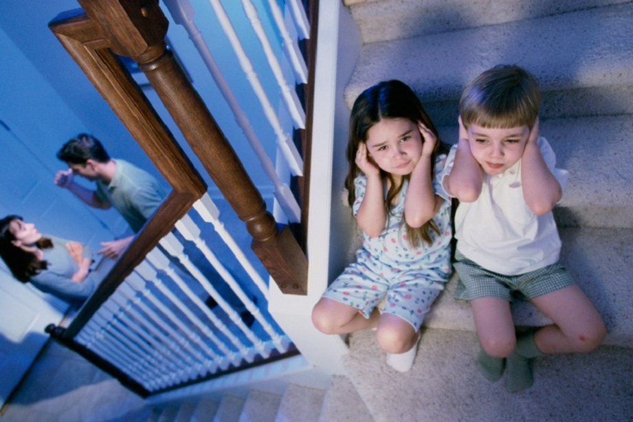
Mostly, these visits affect children more especially because they are highly disappointed as their means of bringing both of their parents together do not work.
This breaks their hearts and they learn that they have to stay in two separate worlds for the rest of their lives.
Additionally, this disintegrates their values, beliefs and living.

Slide 10
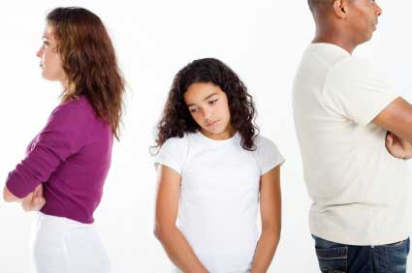
How the book relates to theory
The theory that relates to this book is the modern social exchange theory.
In this case, people try to behave in a manner that maximizes their benefits.

Slide 11
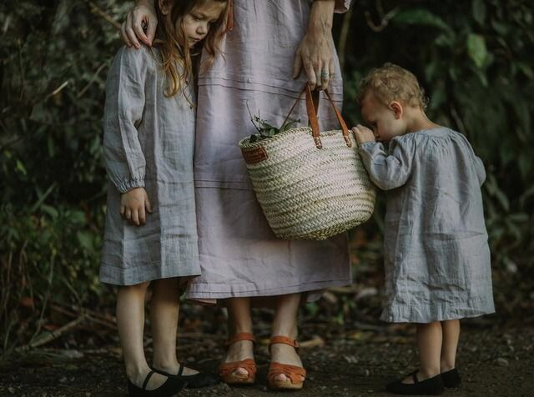
Therefore, many parents decide to divorce each other for the best of reasons but they forget that their decision affects
their children’s
development
negatively.

Slide 12
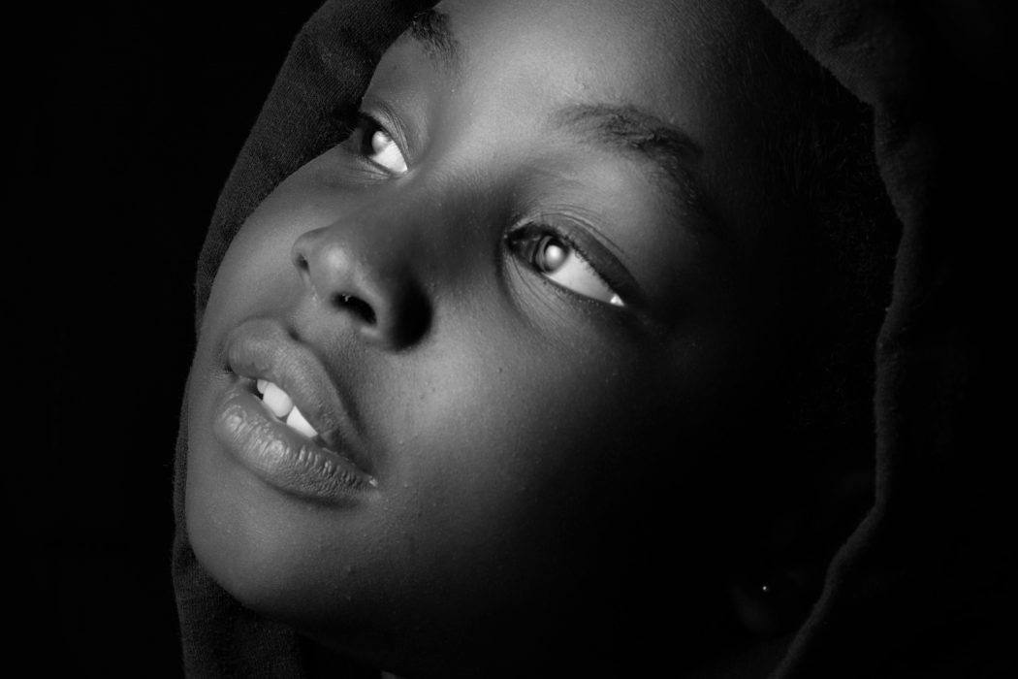
The authors also portray that children of divorce are less likely to feel safe at home because they lack the companion of both of their parents.

Slide 13
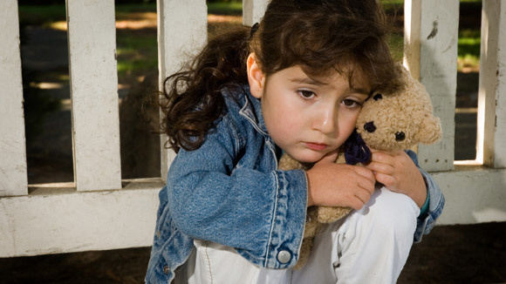
The two theories that better fits in the book are modern social exchange theory and family system theory.
This is because they have a relationship in that parents only consider their benefits alone and act rationally without caring for their children who are going to belong to two separate worlds.

Slide 14
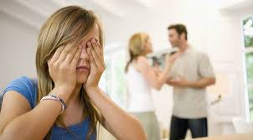
In addition, the children are known to be the direct victims
This brings about the importance of the theories which is to urge all parents to always look into their children’s future first before undertaking a divorce.

Slide 15
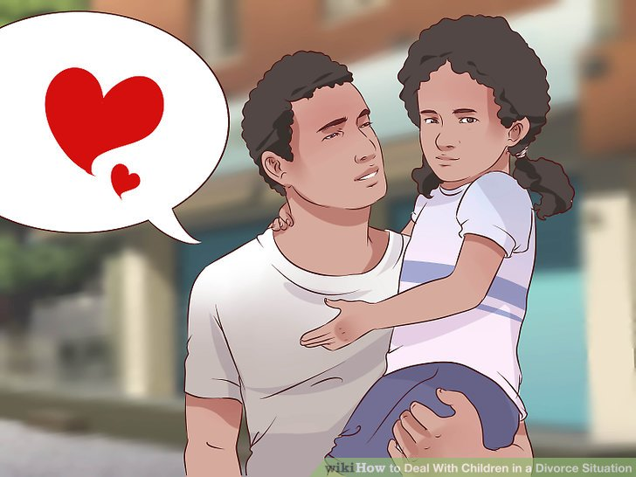
In this case, the theories guides the parents to always miss to offer their children emotional support.
This is particularly because all they are left with is pity for their lives when they compare themselves to children of intact families.

Slide 16
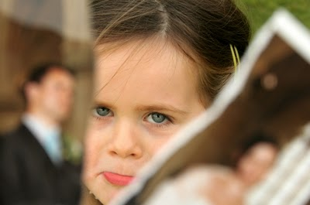
In relation to the two theories, divorce make children start having different thoughts about both of their parents to a point that they are not certain of whether they were right when they decided to divorce.

Slide 17
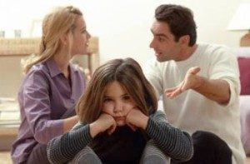
We have learned that, the two authors share stories of children who have been through divorce families and conclude that it is quite harmful to their growth and development and therefore if possible it should be simply avoided.

Slide 18
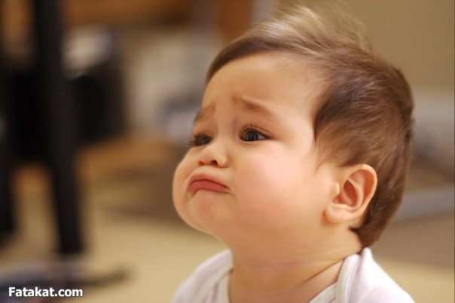
In conclusion, the author says that parents tend to have conflicts after they divorce each other.
This continues to affect children and force them to belong to two separate worlds, which would have been none of their wishes or thoughts.

Slide 19
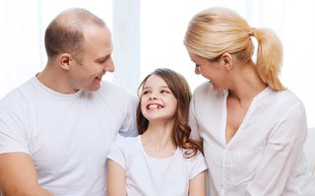
Finally, the authors argue that no divorce is better but parents should always consider the amicable one because it at least brings some hope to the children.

Slide 20

Being attracted to someone is a normal thing. Feeling an attraction, temptation, or desire does not mean you should end your marriage.
Just because you're not feeling love towards your partner doesn't mean you can't recreate it

